Slide 1

Diffraction of Light
MD. GULAM MUSTAFA
Lecturer (Physics)
Department of Science & Humanities
Bangladesh Army International University of Science and Technology (BAIUST)
Syedpur, Cumilla-3501

Slide 2

Whatever we will discuss
Diffraction and its classification
Diffraction by single slit
Related mathematical problems

Slide 3
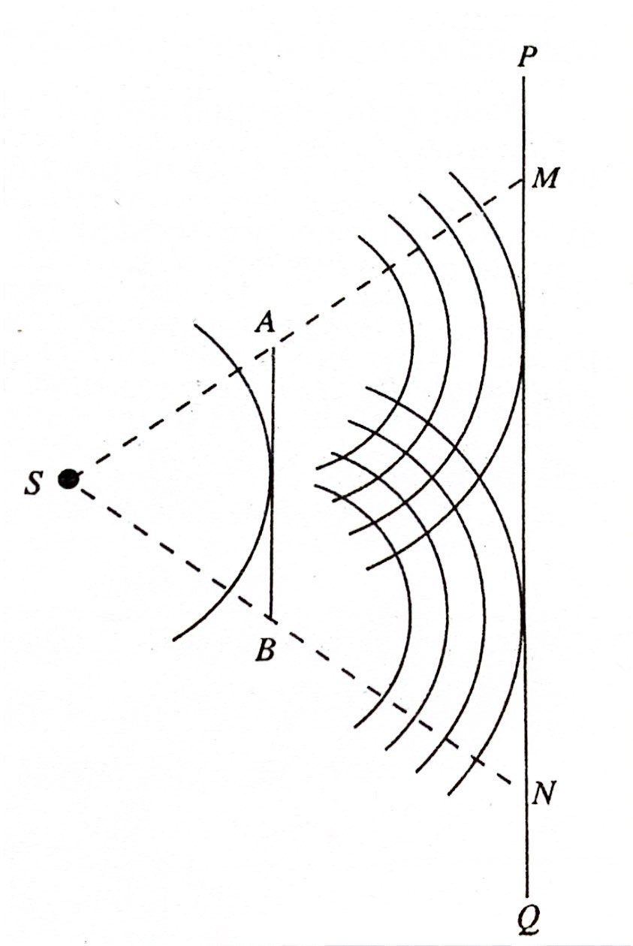
Diffraction
The bending of light into the geometrical shadow area when light passes along the edge of a sharp obstacle or going through a narrow slit is called the diffraction of light.
The diffraction is observable when the size of the sharp edge obstacle or the slit is comparable with the wavelength of light. All sorts of wave exhibit diffraction.
Fig : Diffraction of light

Slide 4
The diffraction phenomena are broadly classified into two types:
Types of diffraction
Fresnel diffraction: In the Fresnel class of diffraction, the source or the screen or the both are at finite distances from the aperture or obstacle causing diffraction.
In this case the incident wave front is either spherical or cylindrical.
This type of diffraction is found when spherical wave front falls on s needle, thin slit.
Fraunhoffer diffraction: In the Fraunhoffer class of diffraction phenomena, the source and the screen on which the pattern is observed are at infinite distances from the aperture or the obstacle causing diffraction.
In this case the incident wave front is plane.
Single or double slit, diffraction grating etc produce this type of diffraction.

Slide 5
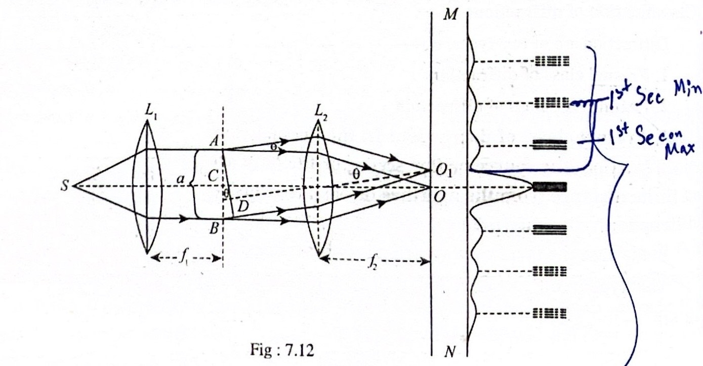
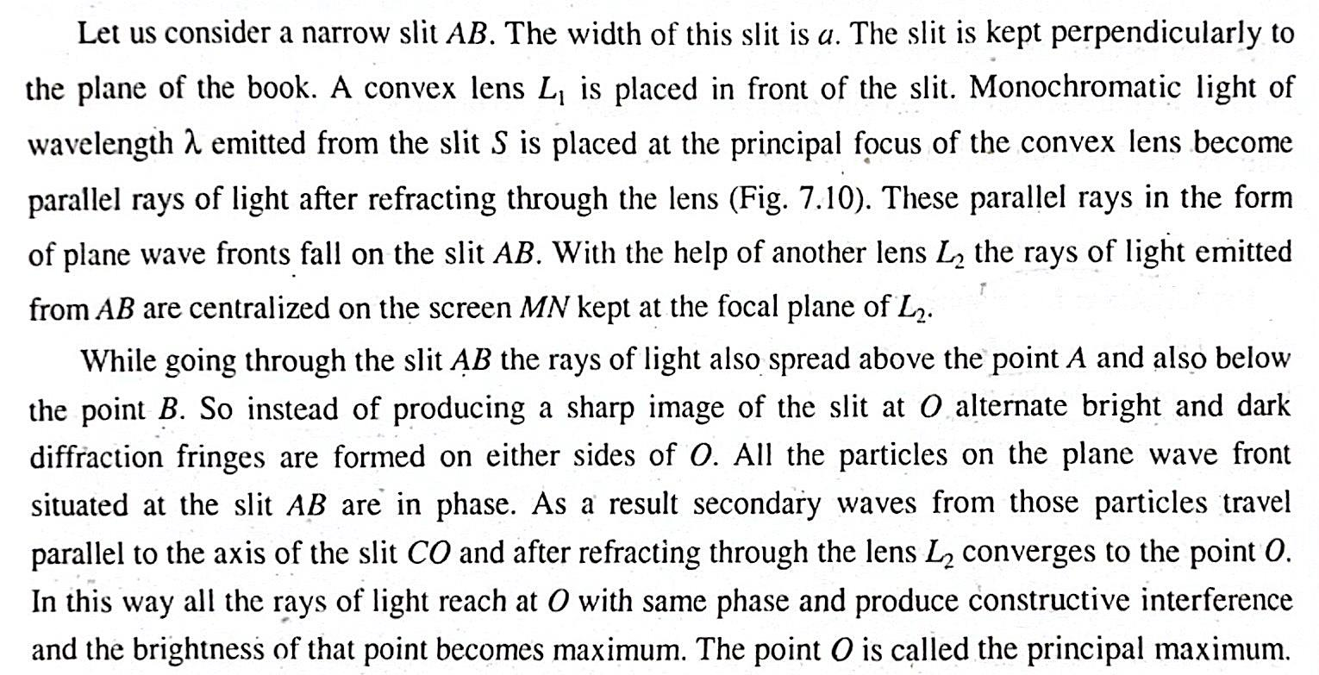
Diffraction by single slit

Slide 6
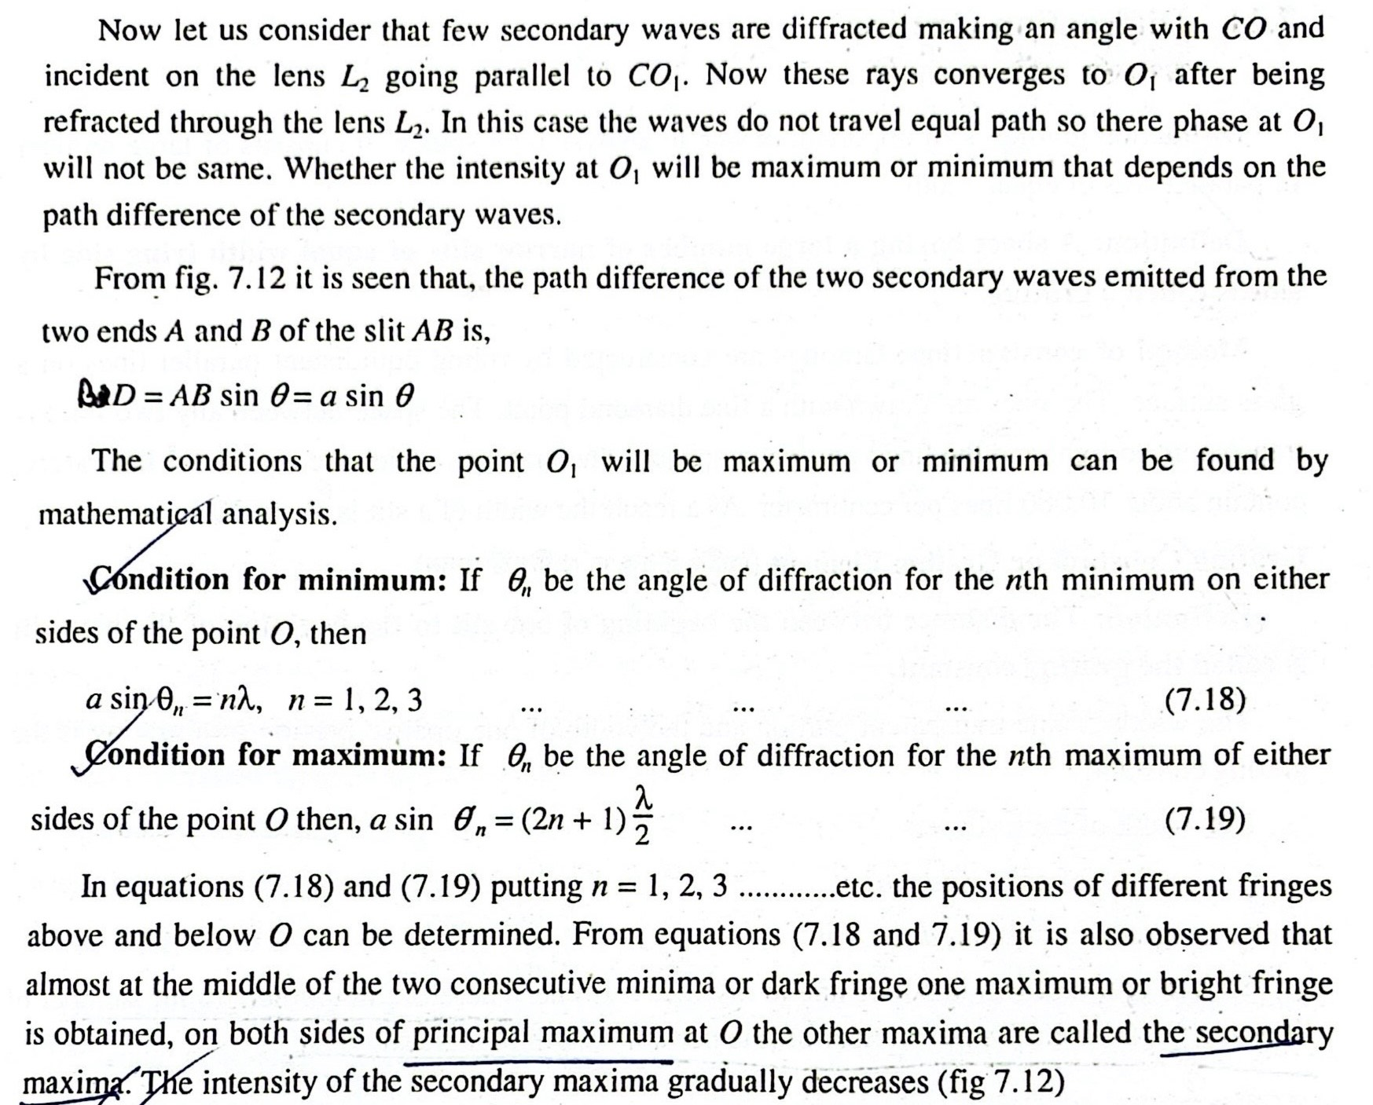

Slide 7
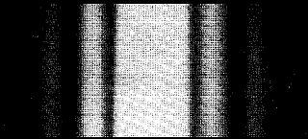
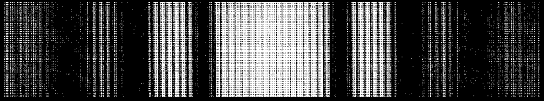
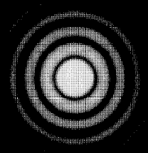

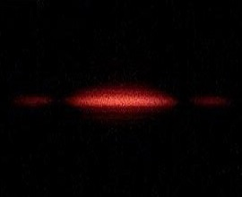
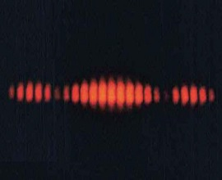
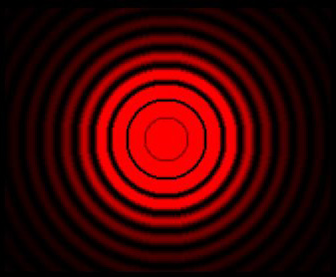
Diffraction patterns
Diffraction by single slit
Diffraction by double slits
Diffraction by circular aperture

Slide 8
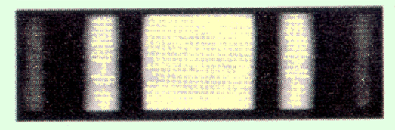
Related Mathematical Problems (Single Slit)
    Find the half angular width of the central bright maximum in the Fraunhoffer diffraction pattern of a slit of width 12 x 10⁻⁵ cm when the slit is illuminated by monochromatic light of wavelength 6000 Å. [Old edition-451 page(Exmp-9.9), New edition-461 page(Ex.-1)] Ans. 30⁰
    In Fraunhoffer diffraction pattern due to a narrow slit a screen is placed 2m away from the lens to obtain the pattern. If the slit width is 0.2 mm and the first minima lie 5 mm on either sides of the central maximum, find the wavelength of light. [Old edition-451 page (Exmp-9.10), New edition-456 page (Exam-18.1)] Ans. 5000 Å
    A single slit of width 0.14 mm is illuminated normally by monochromatic light and diffraction bands are observed on a screen 2m away. If the centre of the second dark band is 1.6 cm from the middle of the central bright band, deduce the wavelength of light used. [Old edition-452 page (Exmp-9.12), New edition-456 page (Exam-18.1)] Ans. 5600 Å
    Find the angular width of the central bright maximum in the Fraunhoffer diffraction pattern of a slit of width 12 x 10⁻⁵ cm when the slit is illuminated by monochromatic light of wavelength 6000 Å. [Old edition-454 page (Exam-9.14)] Ans. 60⁰

Slide 9


